Slide 1

Microsoft Defender Will Be Defended - MemoryRanger Prevents Blinding Windows AV
Denis Pogonin
Igor Korkin
2022

Slide 2


WHO WE ARE
Denis Pogonin
Bachelor of Information Security
National Research Nuclear University MEPhI
Cryptology and Cybersecurity Department
Igor Korkin, PhD
Independent Security Researcher
Speaker at CDFSL, BlackHat, HITB, SADFE
sites.google.com/site/igorkorkin

Slide 3
Agenda
Bypassing security products is a notorious malware trend
Microsoft Defender is the key target of cyber criminals
Kernel-mode threats are still the most risky
Microsoft Defender Internals: Signature Detection
Windows OS Internals: Mandatory Integrity Control
New kernel attack disables Microsoft Defender
MemoryRanger defends Microsoft Defender

Slide 10


Slide 15
Microsoft Defender is under attacks

Slide 16
Microsoft Defender is under attacks

Slide 17
Driver-based attacks can disable Microsoft Defender

Slide 18

Microsoft Defender is UNDER ATTACKs

Slide 19
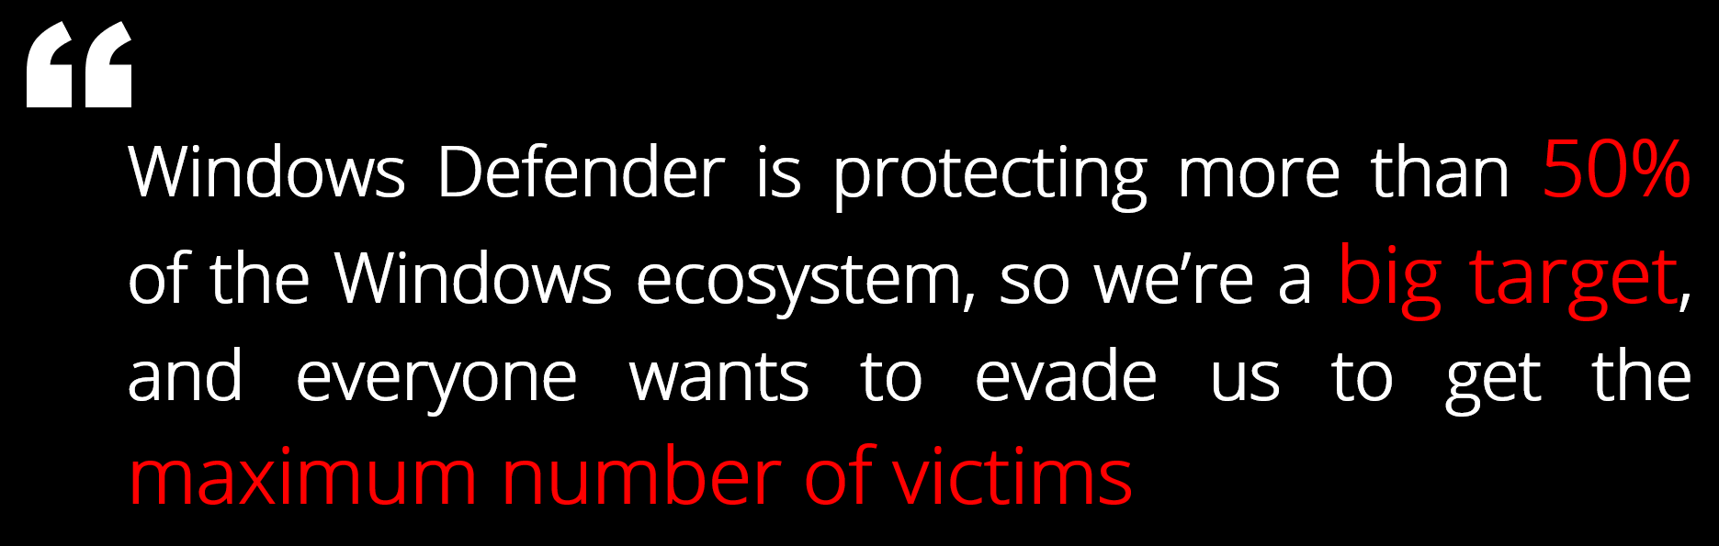

Microsoft Defender is running on over 500 000 000 PCs
Microsoft Defender is protecting more than 50% of the Windows ecosystem, so we’re a big target, and everyone wants to evade us to get the maximum number of victims
Tanmay Ganacharya
Partner Director for Security Research
@ Microsoft Defender for Endpoint
* Top Microsoft Defender expert: These are the threats security hasn't yet solved, ZDNet, 2019
https://www.zdnet.com/article/top-windows-defender-expert-these-are-the-threats-security-hasnt-yet-solved

Slide 20


Attacks on Defender from

Slide 21
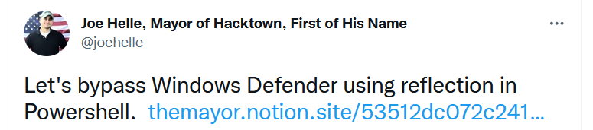
Tweets about Disabling Microsoft Defender

Slide 22
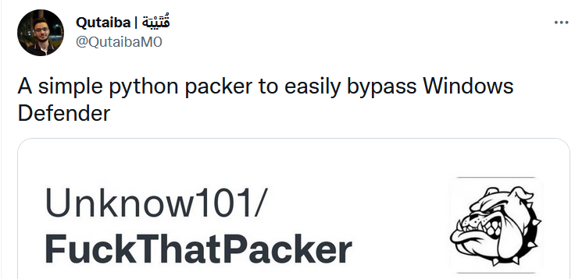
Tweets about Disabling Microsoft Defender
22

Slide 23
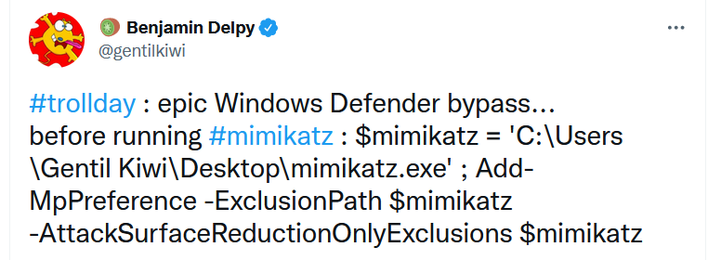
Tweets about Disabling Microsoft Defender
23

Slide 24
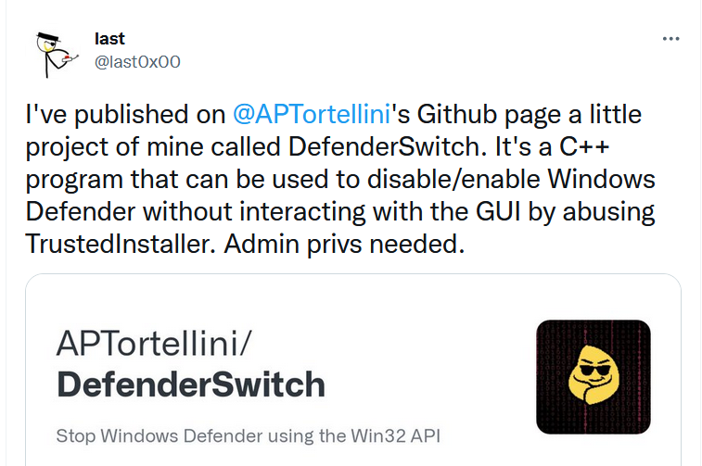
Tweets about Disabling Microsoft Defender

Slide 25
Tweets about Disabling Microsoft Defender

Slide 26
Malware Attacks Microsoft Defender
2020
2021
2022
Ragnarok Ransomware
disables the Microsoft Defender via a registry entry
Zloader Banking Trojan
disables Microsoft Defender via reconfiguring “Set-MpPreference”
Kraken Botnet
bypasses Microsoft Defender via adding exclusions permission

Slide 27
Malware Attacks Microsoft Defender
2020
2021
2022
Ragnarok Ransomware
disables the Microsoft Defender via a registry entry
Zloader Banking Trojan
disables Microsoft Defender via reconfiguring “Set-MpPreference”
Kraken Botnet
bypasses Microsoft Defender via adding exclusions permission

Slide 28
Malware Attacks Microsoft Defender
2020
2021
2022
Ragnarok Ransomware
disables the Microsoft Defender via a registry entry
Zloader Banking Trojan
disables Microsoft Defender via reconfiguring “Set-MpPreference”
Kraken Botnet
bypasses Microsoft Defender via adding exclusions permission

Slide 29
Malware Attacks Microsoft Defender
2020
2021
2022
Ragnarok Ransomware
disables the Microsoft Defender via a registry entry
Zloader Banking Trojan
disables Microsoft Defender via reconfiguring “Set-MpPreference”
Kraken Botnet
bypasses Microsoft Defender via adding exclusions permission

Slide 30
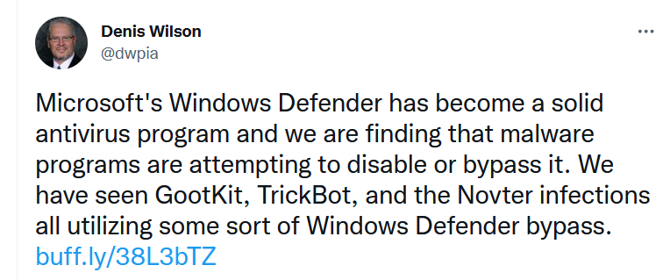
Malware Attacks Microsoft Defender
2020
2021
2022
Ragnarok Ransomware
disables the Microsoft Defender via a registry entry
Zloader Banking Trojan
disables Microsoft Defender via reconfiguring “Set-MpPreference”
Kraken Botnet
bypasses Microsoft Defender via adding exclusions permission

Slide 31
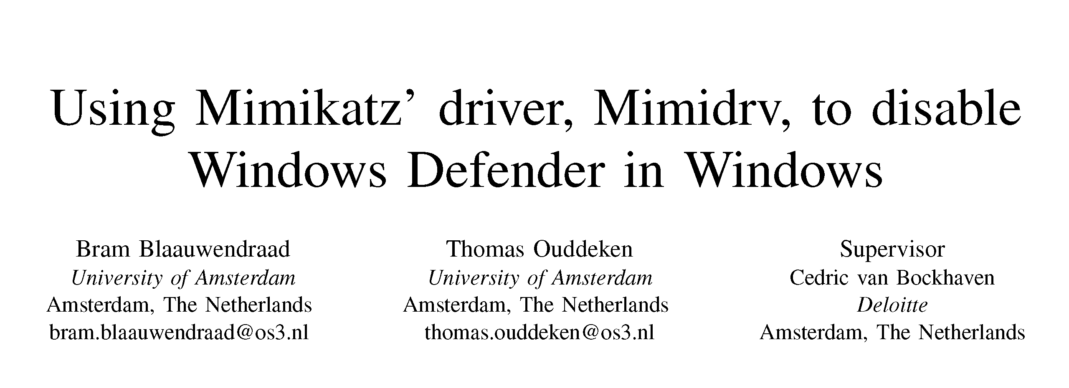
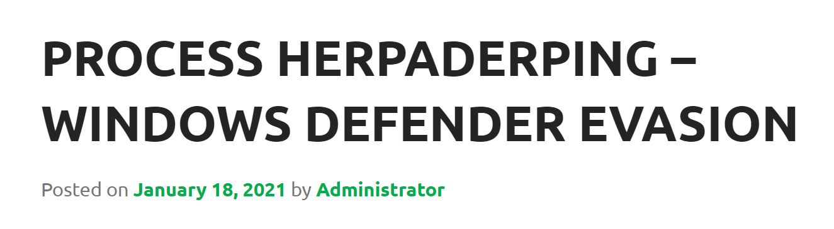
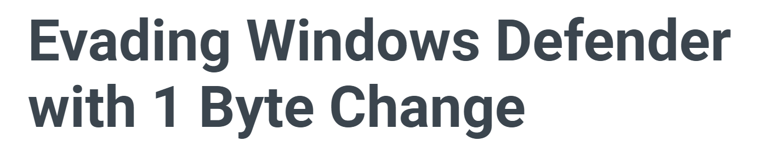

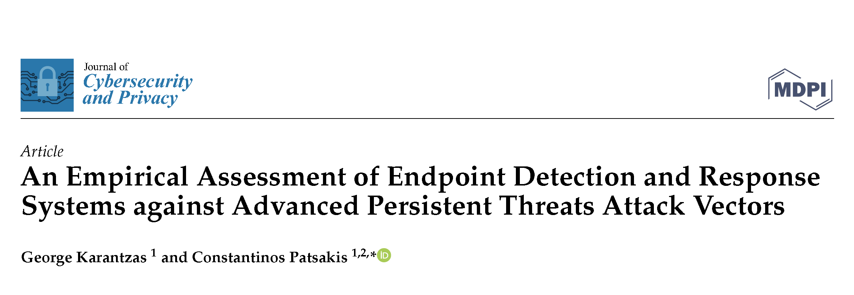
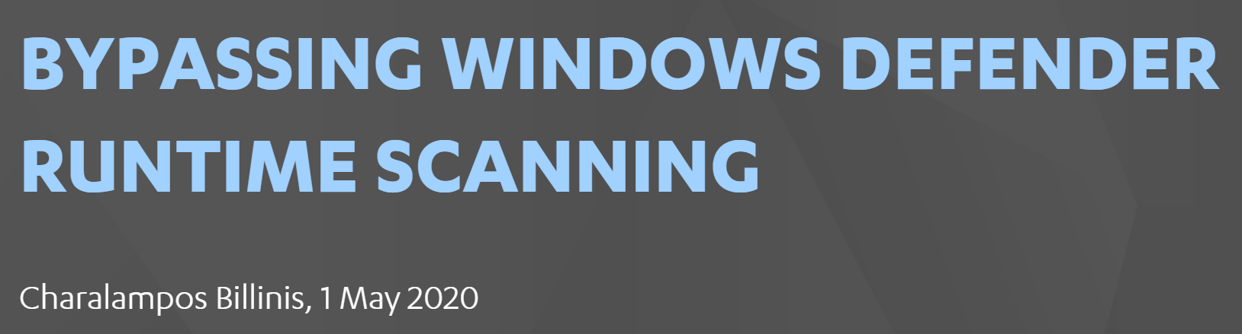
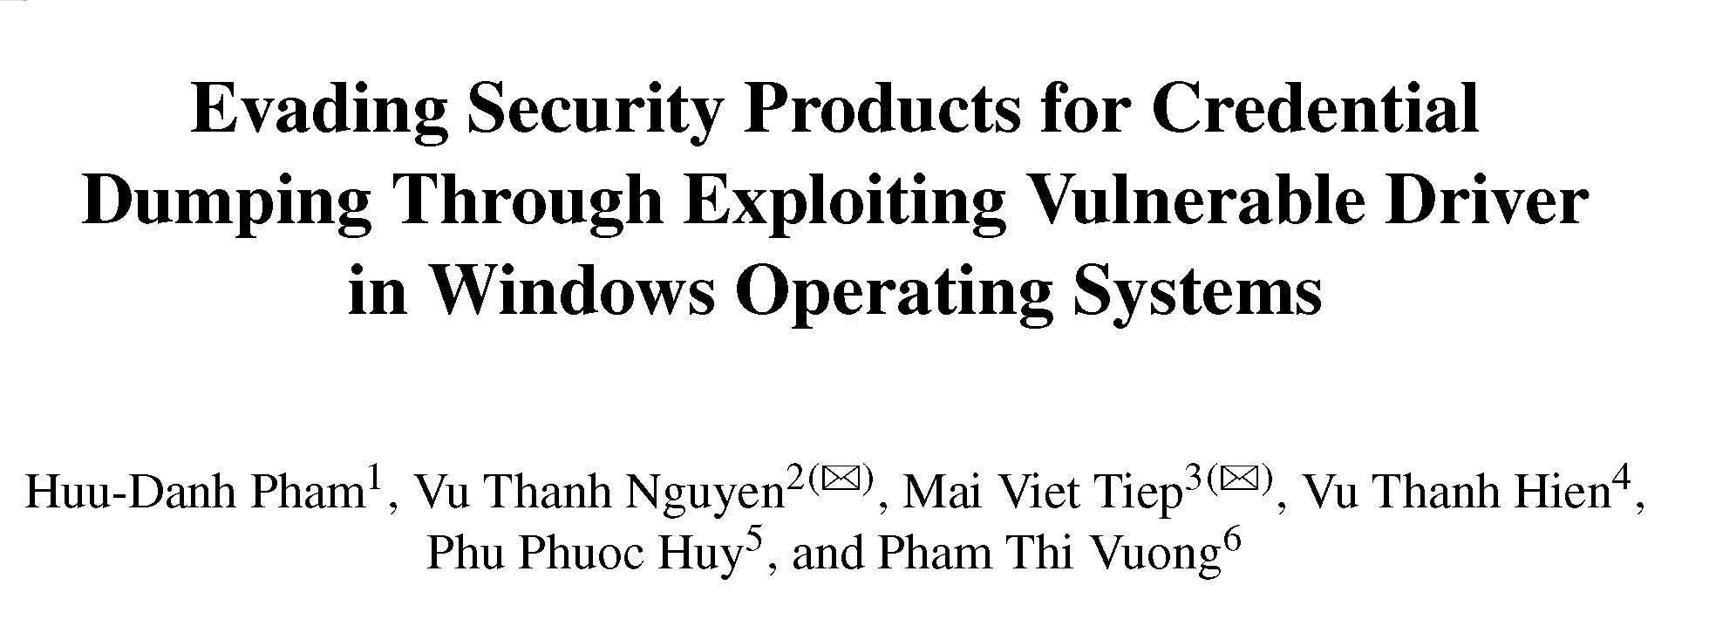
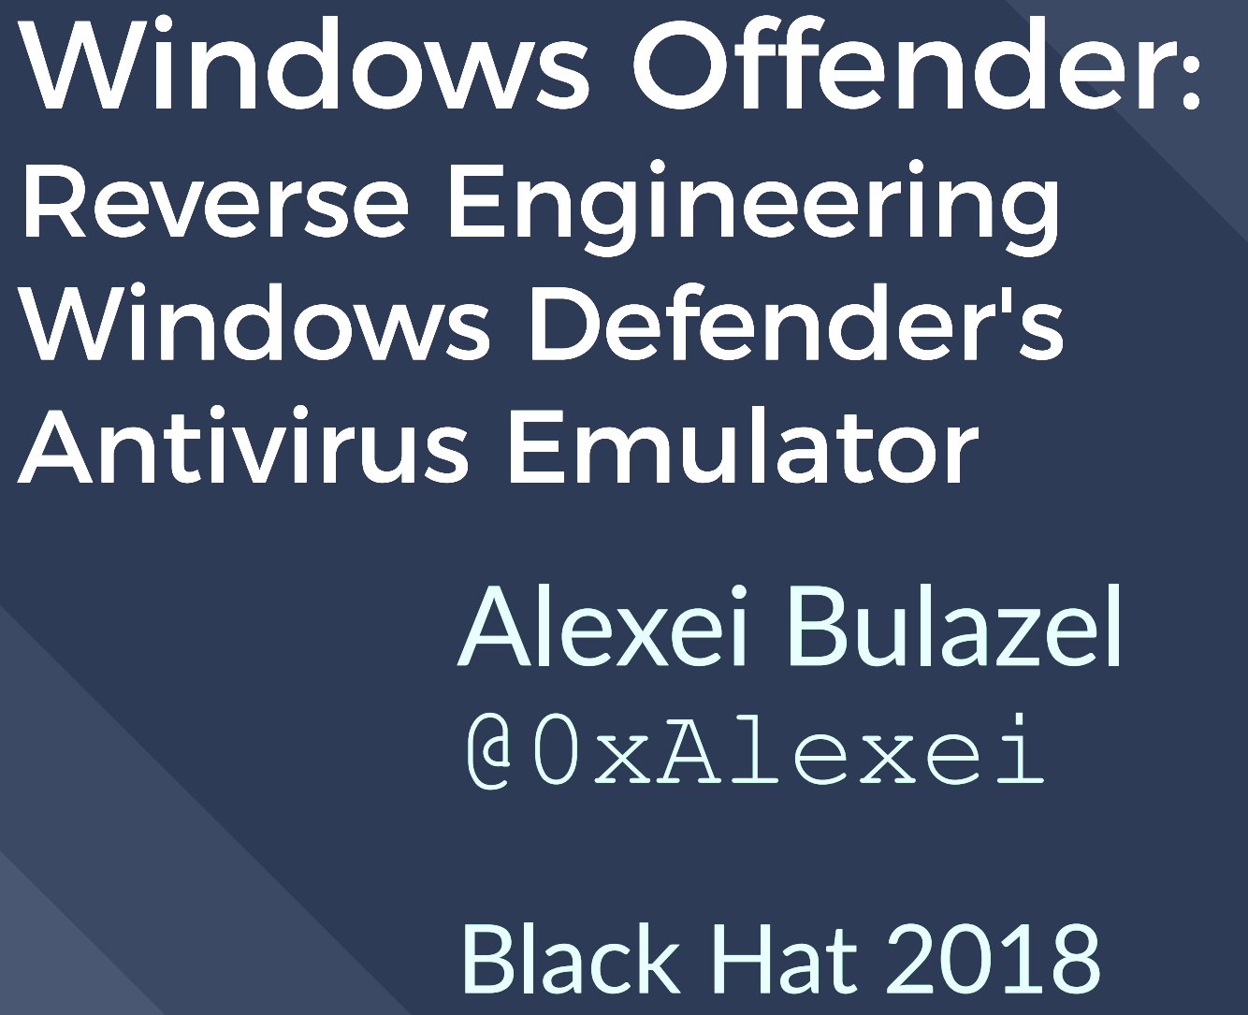

Academic papers and blogs about Attacks on Microsoft Defender

Slide 32

Attack Vectors on Microsoft Defender

Slide 37
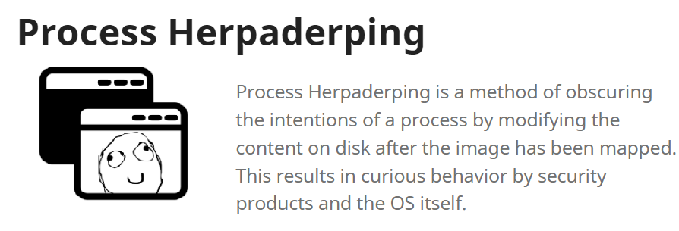

Slide 39


Slide 41

2022-02-02

Slide 43


Slide 44


Slide 45


Slide 47
All the details of these attacks are in the research paper

Slide 49

TRENDS of kernel attacks in 2021-2022

Slide 51
Year | Malware | 3rd party driver
2022 | HermeticWiper | EaseUS
2021 | Iron Tiger | CPUID CPU-Z
 | GhostEmperor | CheatEngine
 | ZINC | eXplorer
 | TunnelSnake | VirtualBox
2020 | RobbinHood | Gigabyte
 | Trickbot | RWEverything
. . .
More than 30 malware examples that abuse vulnerable signed drivers

Slide 53
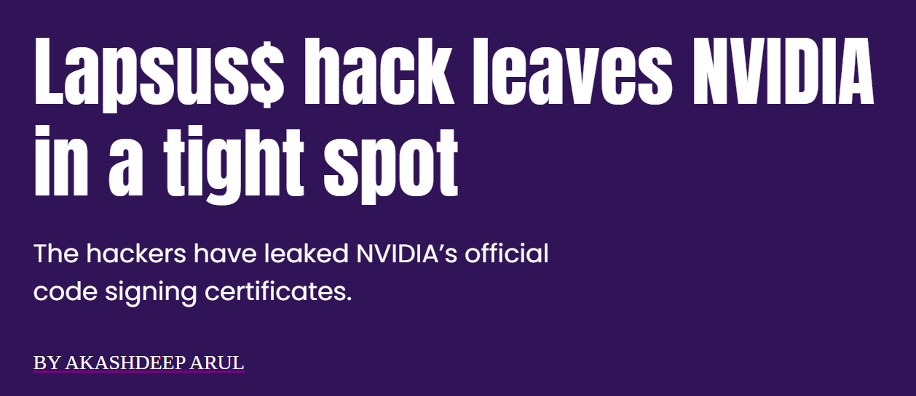
2022
March 1

Slide 54
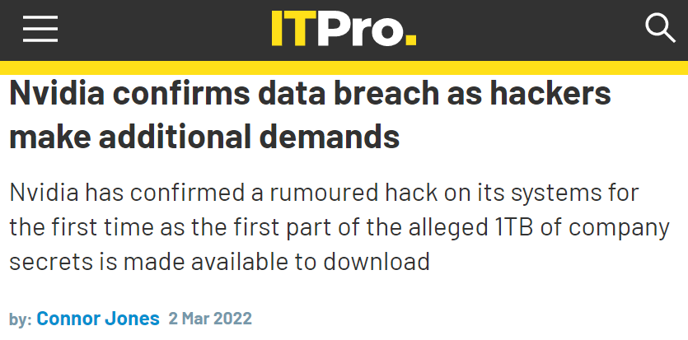
2022
March 1
March 2

Slide 55
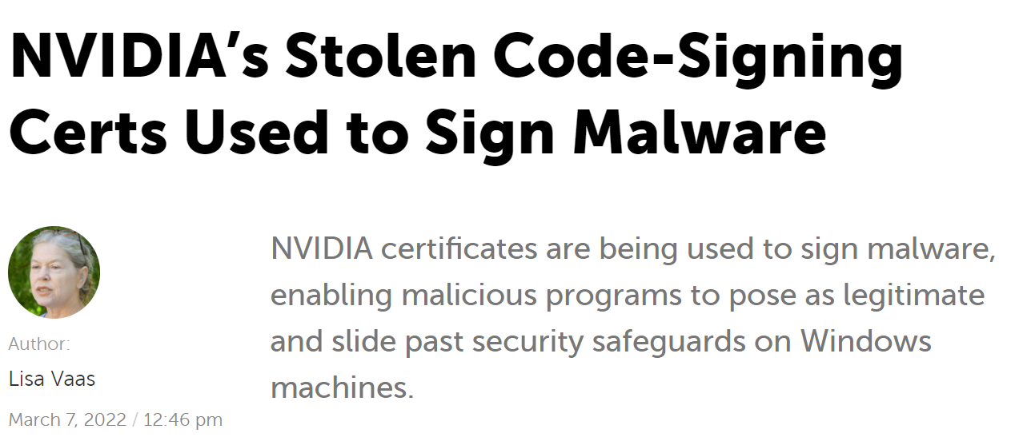
2022
March 1
March 2
March 7

Slide 56

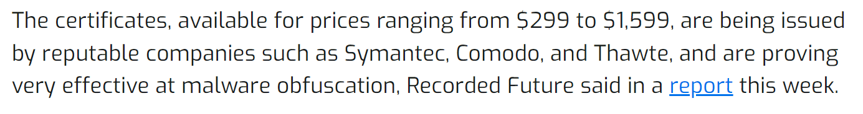

Slide 57

57

Slide 58
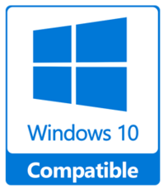
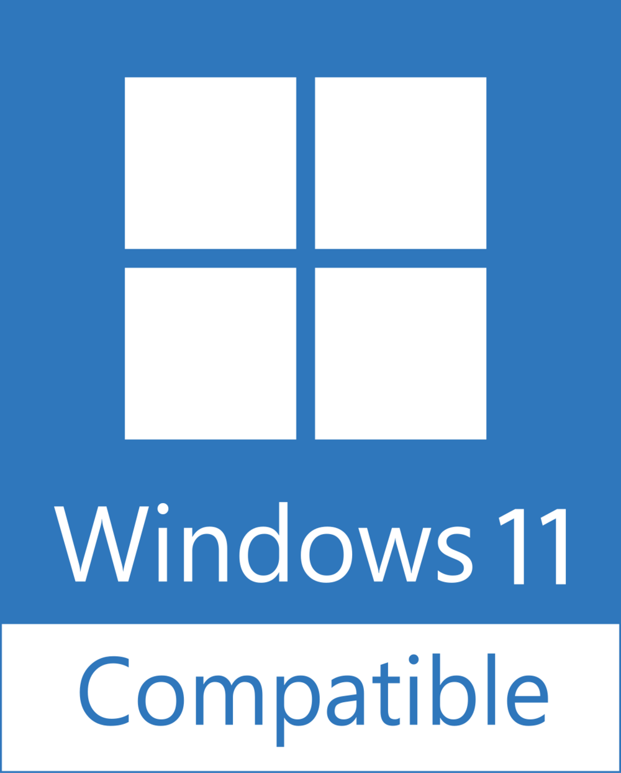
Microsoft creates Windows Hardware Quality Labs (WHQL) to test drivers and award a digital signature when all requirements are fulfilled.
58

Slide 59
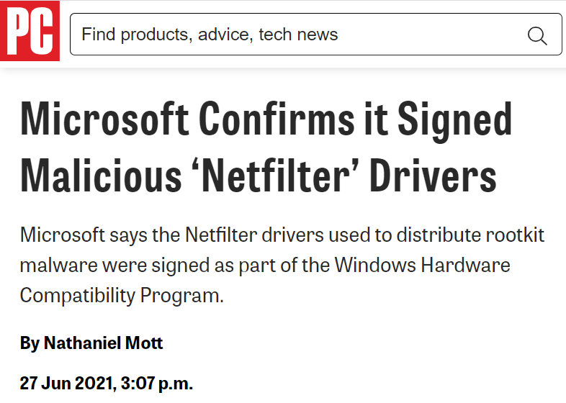
2021
June
59

Slide 60
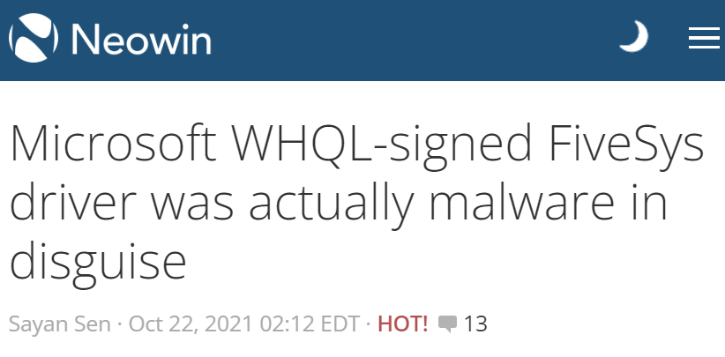
2021
June
October
60

Slide 62
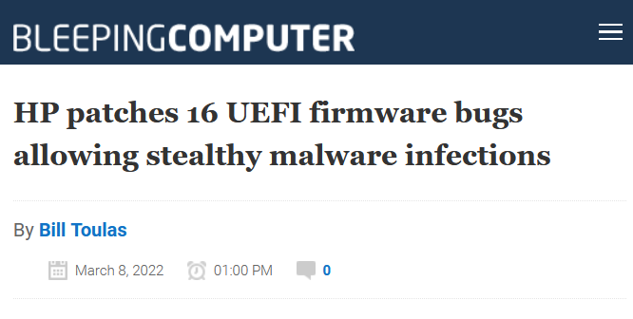
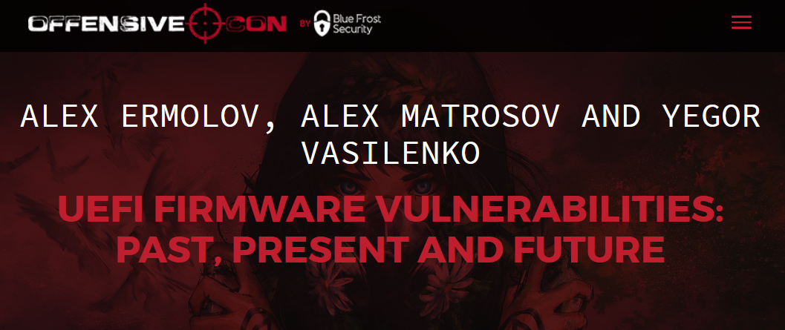

Slide 64

Microsoft Defender: INTRO

Slide 65
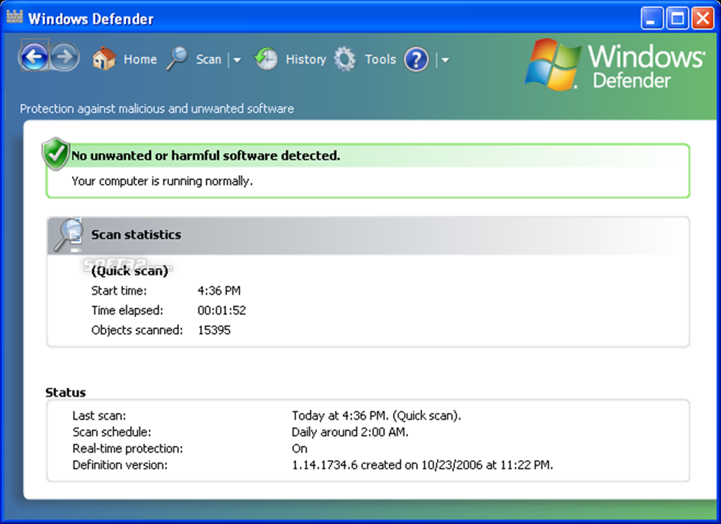
Microsoft Defender: Intro
2005 – the first release as a free anti-spyware program

Slide 66
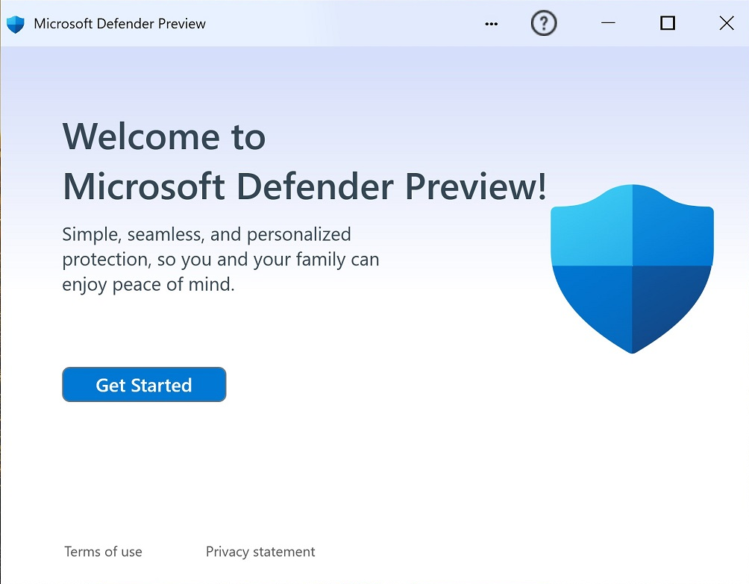
Microsoft Defender: Intro
2005 – the first release as a free anti-spyware program
2019 – Gartner: Microsoft Defender is the Leader in the Endpoint Protection Platforms (EPP) Magic Quadrant.

Slide 67

Microsoft Defender: components

Slide 68
Microsoft Defender: about 10 apps + 6 drivers
User-mode Processes and Services
MsMpEng
WinDefend
MsSense
NisSrv.exe
WdNisSvc
MsMpEngCP
MpCopyAccelerator
SecurityHealthService
WSCSVC
MPSSVC
Kernel-mode Drivers
WdFilter (file-filter)
WdDevFlt (device-filter)
MpsDrv (firewall)
WdBoot (ELAM)
WdNisDrv (NDIS WFP)
MpKSLDrv (update)

Slide 69
Microsoft Defender: about 10 apps + 6 drivers
User-mode Processes and Services
MsMpEng
WinDefend
MsSense
NisSrv.exe
WdNisSvc
MsMpEngCP
MpCopyAccelerator
SecurityHealthService
WSCSVC
MPSSVC
Kernel-mode Drivers
WdFilter (file-filter)
WdDevFlt (device-filter)
MpsDrv (firewall)
WdBoot (ELAM)
WdNisDrv (NDIS WFP)
MpKSLDrv (update)
• %ProgramData%\Microsoft\Microsoft Defender\Platform
• %Windir%\System32\drivers\wd

Slide 70
Microsoft Defender: about 10 apps + 6 drivers
User-mode Processes and Services
MsMpEng
WinDefend
MsSense
NisSrv.exe
WdNisSvc
MsMpEngCP
MpCopyAccelerator
SecurityHealthService
WSCSVC
MPSSVC
Kernel-mode Drivers
WdFilter (file-filter)
WdDevFlt (device-filter)
MpsDrv (firewall)
WdBoot (ELAM)
WdNisDrv (NDIS WFP)
MpKSLDrv (update)
• %ProgramData%\Microsoft\Microsoft Defender\Platform
• %Windir%\System32\drivers\wd

Slide 71
Microsoft Defender: Internals
MsMpEng.exe
User-mode
Kernel-mode

Slide 72
Microsoft Defender: Internals
MsMpEng.exe
User-mode
Kernel-mode
Inspects the newly created files to remove malicious
WdFilter
(file-filter)
Files on the disk

Slide 73
Microsoft Defender: Internals
MsMpEng.exe
Inspects the newly created processes to block malicious
Newly created processes
Newly created process
User-mode
Kernel-mode
Inspects the newly created files to remove malicious
WdFilter
(file-filter)
Files on the disk

Slide 74

Microsoft Defender: Internals
MsMpEng.exe
Inspects the newly created processes to block malicious
Newly created processes
MpEngine.dll
Newly created process
The core of AV detection includes 45,000+ functions
User-mode
Kernel-mode
Inspects the newly created files to remove malicious
WdFilter
(file-filter)
Files on the disk

Slide 75



Microsoft Defender: Internals
MsMpEng.exe
Newly created processes
Newly created process
WdFilter
(file-filter)
Files on the disk

Slide 76
Mandatory Integrity Control: Intro

Slide 84
Defender TRIES TO open a file

Slide 85
Defender TRIES TO open a file

Slide 86
Defender TRIES TO open a file

Slide 87
Defender FAILS TO open a file

Slide 88



MIC: Integrity Levels

Slide 89
MIC: Integrity Levels

Slide 90



MIC: Integrity Levels

Slide 91



MIC: Integrity Levels

Slide 92
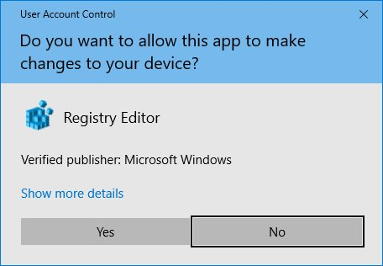

MIC: Integrity Levels

Slide 93

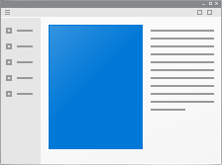
MIC: Integrity Levels

Slide 94
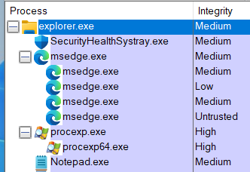
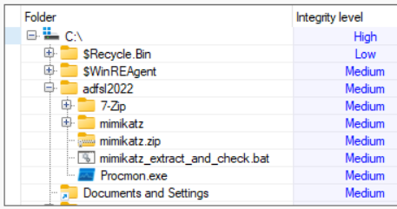
MIC: Integrity Levels of files and folders
* MicEnum – www.elevenpaths.com/innovation-labs/technologies/micenum

Slide 95
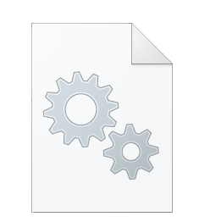
MIC is based on Bell-LaPadula Model (BLP)
App
File
App tries to overwrite a file

Slide 96


MIC is based on Bell-LaPadula Model (BLP)
App
File
App tries to overwrite a file
$${IL}_{APP}$$
$${IL}_{FILE}$$
Access check
Access is blocked
Access is allowed

Slide 97
MIC is based on Bell-LaPadula Model (BLP)
App
File
App tries to overwrite a file
$${IL}_{APP}$$
$${IL}_{FILE}$$
$$if \left({IL}_{APP}≥{IL}_{FILE}\right)→access is allowed$$
Access check
$$else →access is blocked$$
Access is blocked
Access is allowed

Slide 98

MIC is based on Bell-LaPadula Model (BLP)
App
File
App tries to overwrite a file
$$Low IL$$
$${IL}_{FILE}$$
$$if \left({IL}_{APP}≥{IL}_{FILE}\right)→access is allowed$$
Access check
$$else →access is blocked$$
Apps with Low IL cannot get write access to the most OS objects
Access is blocked
Access is allowed
98

Slide 99

How Integrity level are stored in Windows?

Slide 100
MIC Internals: Token structure
APP
User-mode
EPROCESS structure
Kernel-mode

Slide 101
MIC Internals: Token structure
APPs
APP
User-mode
Kernel-mode
EPROCESS structure

Slide 102
MIC Internals: Token structure
APPs
APPs
APPs
User-mode
Kernel-mode
EPROCESS structure

Slide 103
MIC Internals: Token structure
APPs
APPs
APPs
User-mode
Kernel-mode
EPROCESS structure
ImageName
ProcessID
Token

Slide 104
MIC Internals: Token structure
APPs
APPs
APPs
User-mode
Kernel-mode
EPROCESS structure
ImageName
ProcessID
Token
void* Object
TOKEN structure

Slide 105
MIC Internals: Token and Index
TOKEN structure
SID_AND_ATTRIBUTES * UserAndGroups
SID_AND_ATTRIBUTES
UserAndGroups[0]

Slide 106
MIC Internals: Token and Index
TOKEN structure
SID_AND_ATTRIBUTES * UserAndGroups
ULONG IntegrityLevelIndex
SID_AND_ATTRIBUTES
UserAndGroups[0]
SID_AND_ATTRIBUTES
UserAndGroups [IntegrityLevelIndex]
ULONG Attributes
VOID* Sid

Slide 107
MIC Internals: Token and Index
TOKEN structure
SID_AND_ATTRIBUTES * UserAndGroups
ULONG IntegrityLevelIndex
Integrity level SID
SID_AND_ATTRIBUTES
SID value | Integrity Level
S-1-16-8192 | Medium
S-1-16-12288 | High
S-1-16-16384 | System
SID_AND_ATTRIBUTES
ULONG Attributes
VOID* Sid

Slide 108

How Windows OS gets Integrity Levels?

Slide 109
MIC: Get Integrity Level
GetTokenInformation(TokenIntegrityLevel)
Some App
MsMpEng

Slide 110
MIC: Get Integrity Level
GetTokenInformation(TokenIntegrityLevel)
Some App
MsMpEng
kernelbase
GetTokenInformation
ntdll
NtQueryInformationToken
nt
NtQueryInformationToken
SepCopyTokenIntegrity
SepLocateTokenIntegrity

Slide 111
MIC: Get Integrity Level
GetTokenInformation(TokenIntegrityLevel)
Some App
MsMpEng
kernelbase
GetTokenInformation
ntdll
NtQueryInformationToken
nt
NtQueryInformationToken
SepCopyTokenIntegrity
SepLocateTokenIntegrity

Slide 112
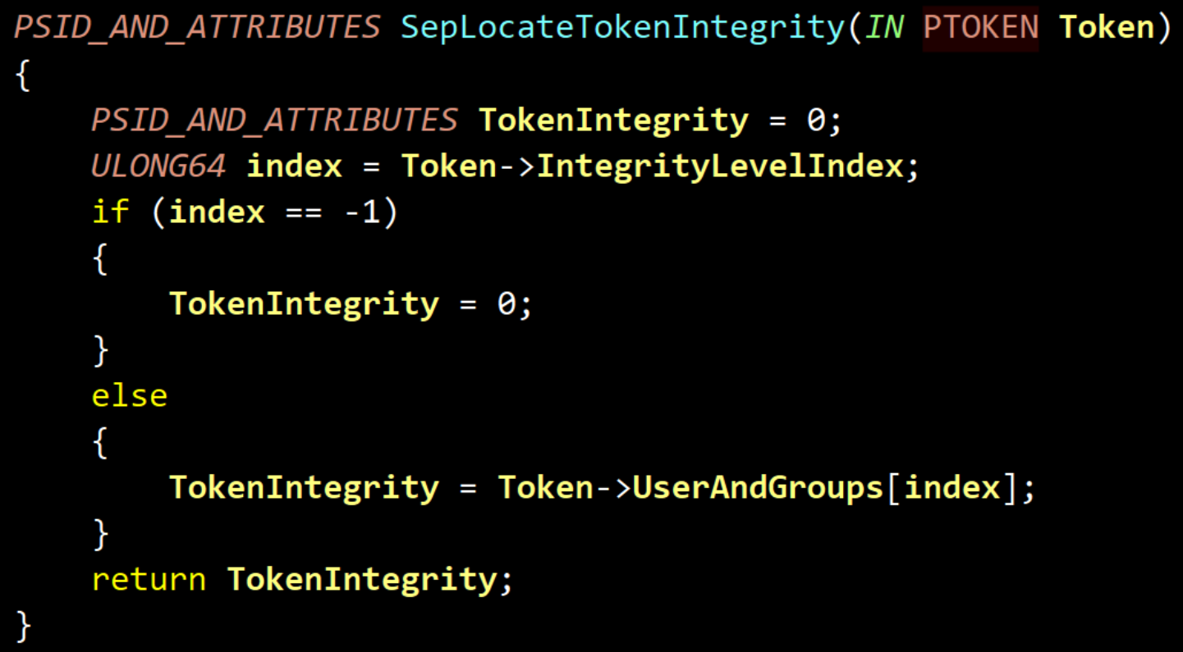

Slide 116
MIC: Get Integrity Level
GetTokenInformation(TokenIntegrityLevel)
Some App
MsMpEng
kernelbase
GetTokenInformation
ntdll
NtQueryInformationToken
nt
NtQueryInformationToken
SepCopyTokenIntegrity
SepLocateTokenIntegrity

Slide 117
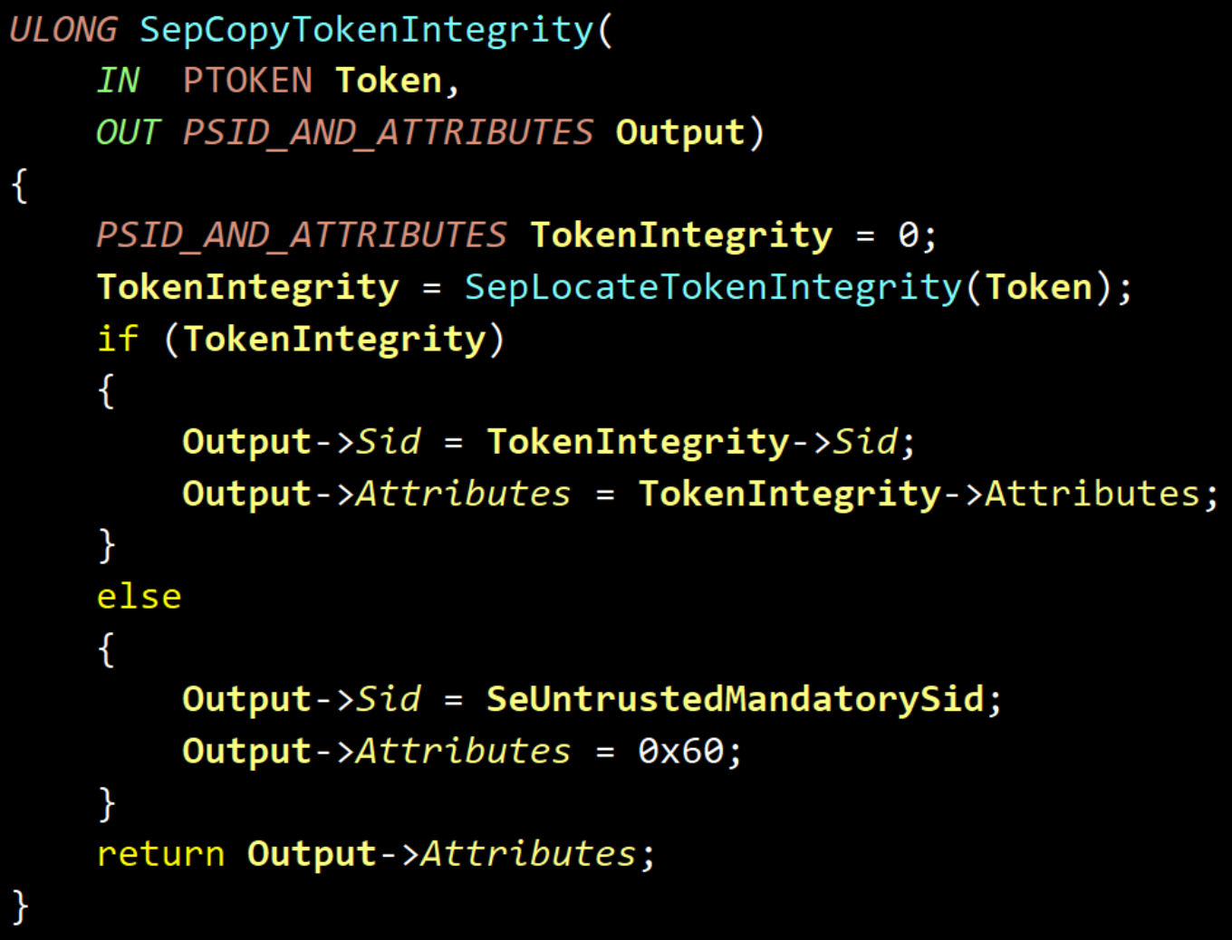

Slide 121
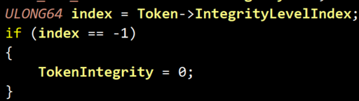

Slide 122

Attack on MIC

Slide 123
Attack on MIC: SCHEME

Slide 124
Attack on MIC: SCHEME

Slide 125
Attack on MIC: SCHEME

Slide 126
Attack on MIC: SCHEME

Slide 127
Attack on MIC: SCHEME

Slide 128
Attack on MIC: SCHEME

Slide 129
Attack on MIC: SCHEME

Slide 131
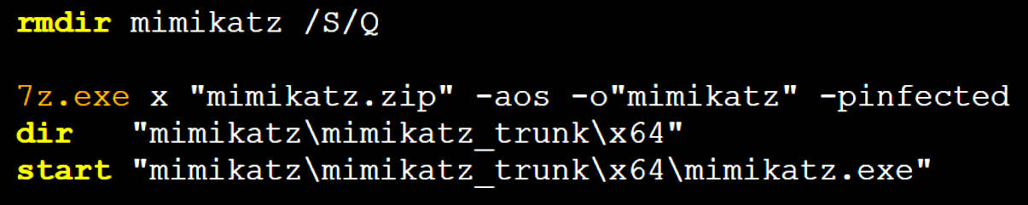
clear_extract_and_check.bat:

Slide 132
Attack on MIC: DEMO
The online version is here – https://www.youtube.com/embed/AJV4UVaw8kg?vq=hd1440

Slide 134
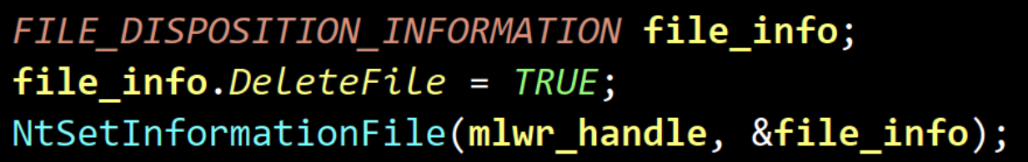
Summary
Microsoft Defender app removes malware files via call:
CMD fails to launch mimikatz with STATUS_VIRUS_INFECTED (0xC0000906) that is returned by AV to block running malware app

Slide 135
Summary
Microsoft Defender app removes malware files via call:
CMD fails to launch mimikatz with STATUS_VIRUS_INFECTED (0xC0000906) that is returned by AV to block running malware app
Which driver returns this status?

Slide 136
Microsoft Defender: Internals
MsMpEng.exe
Inspects the newly created processes to block malicious
Newly created processes
MpEngine.dll
Newly created process
WdFilter
(file-filter)
Inspects the newly created files to remove malicious
Files on the disk

Slide 137
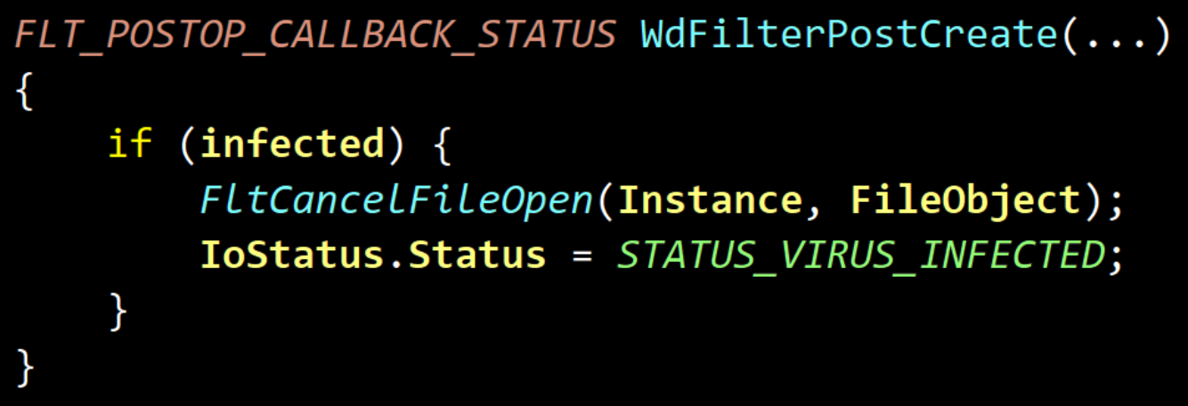
WDFilter
It register a mini-filter via FltRegisterFilter()
It prevents launching a malware via post-create callback

Slide 138
WDFilter
It register a mini-filter via FltRegisterFilter()
It prevents launching a malware via post-create callback
Defender is still able to access apps memory. But how?

Slide 139

How can Microsoft Defender get access to apps memory?

Slide 140
Defender opens a process

Slide 141
Defender opens a process

Slide 142
Defender opens a process

Slide 143
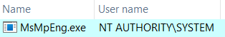
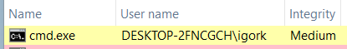
DEBUG PRIVILEGE ALLOWS TO GET ACCESS TO ALL APPS MEMORY
To open a process running on another user account MsMpEng has “SeDebugPrivilege” privilege

Slide 144
Defender opens a process

Slide 145
Defender opens a process

Slide 146
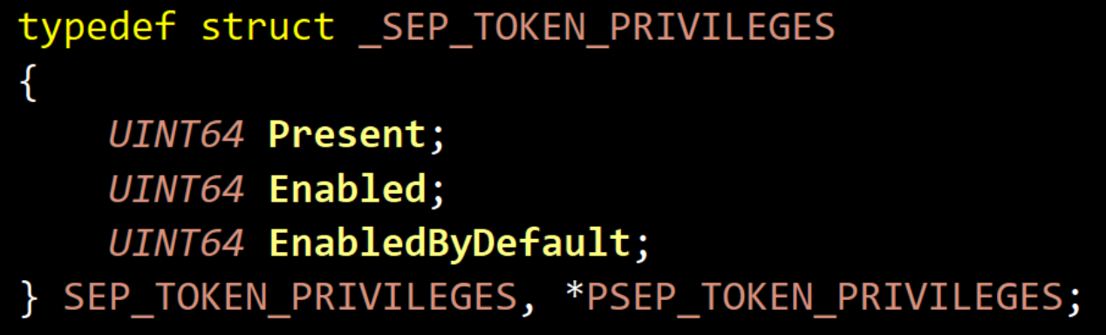
TOKEN Privileges
Research results:
revoking “SeDebugPrivilege” from “Enabled”
is enough to prevent Defender from inspecting the apps memory.

Slide 147

Attack on MIC and Token Privilege can disable Microsoft Defender without terminating its apps

Slide 148
Attack on MIC + Token Privilege: SCHEME
148

Slide 149
Attack on MIC + Token Privilege: SCHEME
149

Slide 150
Attack on MIC + Token Privilege: SCHEME
150

Slide 151
Attack on MIC + Token Privilege: SCHEME
151

Slide 152
Attack on MIC + Token Privilege: SCHEME
152

Slide 153
Attack on MIC + Token Privilege: DEMO
The online version is here – https://www.youtube.com/embed/ihhUUd9qJTY?vq=hd1440

Slide 154
Sandboxed Microsoft Defender fails to stop malware

Slide 155
Sandboxed Microsoft Defender fails to stop malware

Slide 156
Sandboxed Microsoft Defender fails to stop malware

Slide 157

This attack can blind Microsoft Defender. What about other AVs?

Slide 158











MIC-based attack blinds top AV solutions
AV Name | AV ability to detect malicious files | AV ability to detect malicious processes
Microsoft Defender | Disabled | Disabled
McAfee | Disabled | Disabled
Malwarebytes | Disabled | Disabled
Avast | Disabled | Disabled
AVG | Disabled | Disabled
Kaspersky | Disabled | Enabled
 | Enabled, but AV cannot remove malware files | Disabled
Disclaimer: The purpose is to provide technical review only. This analysis is not designed to promote any solutions.
We do respect all antiviruses and endpoint security solutions.

Slide 159

MemoryRanger Defends Microsoft Defender

Slide 160
MemoryRanger: Intro

Slide 161
MemoryRanger: Intro

Slide 162
MemoryRanger: Intro

Slide 163
MemoryRanger: Intro

Slide 164
MemoryRanger: Intro

Slide 165
MemoryRanger: Intro

Slide 166
MemoryRanger: Features
Components:
user-mode control app
kernel-mode driver to register OS callbacks
hypervisor based dispatcher based on Intel VT-x and EPT technologies
The key features:
Runs kernel-mode drivers into isolated memory enclaves
Allows different memory access configuration for each memory enclave
Number of enclaves can be increased in runtime (while VBS has fixed 2 enclaves)
Technical features:
Hooks kernel API routines
Redirects illegal access to the sensitive data to the fake content
Supports newest Windows 11 x64 and it is open-source
github.com/IgorKorkin/MemoryRanger

Slide 167






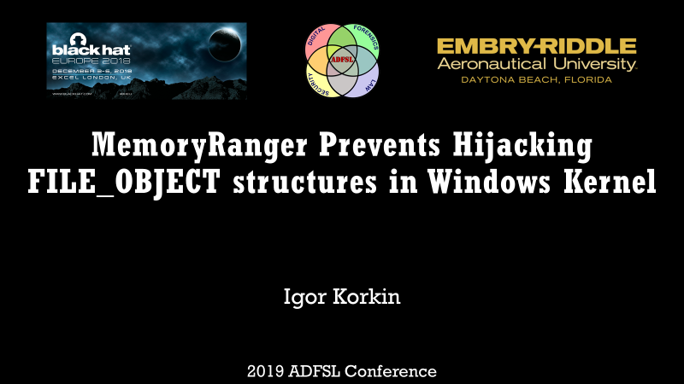

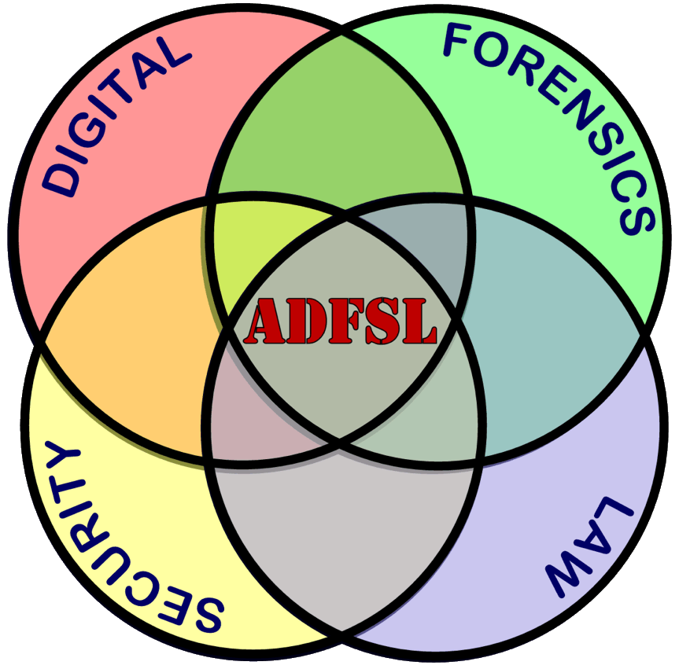
MemoryRanger was in US, UK, and Asia and twice at BlackHat
2018
2019
2020
2021
2022

Slide 168
MemoryRanger Customization protects Microsoft Defender

Slide 169
MemoryRanger Customization protects Microsoft Defender

Slide 170
MemoryRanger Defends Microsoft Defender: Demo
The online version is here – https://www.youtube.com/embed/Ohqhq50wVjI?vq=hd1440

Slide 177
Conclusion
Kernel-mode threats are very dangerous even for Windows 11 x64
The global malware trend is to bypass or disable security products without terminating the AV/EDR apps
Microsoft Defender is the most desired goal for attackers
Mandatory Integrity Control (MIC) is designed to sandbox untrusted apps, but attackers can abuse MIC to sandbox Microsoft Defender and other AVs.
MemoryRanger blocks attacks on kernel data including attacks on MIC

Slide 178

Thank you!
Denis Pogonin | denpog00@gmail.com
Igor Korkin | igor.korkin@gmail.com
All the details are here | igorkorkin.blogspot.com
Notes:
Thank you!

